Slide 1
Detecting Malaria Parasitized Cells in Thin-Blood Smear Microscopy Images
Jithin Thenasseril
ECE 687 Pattern Recognition

Slide 2
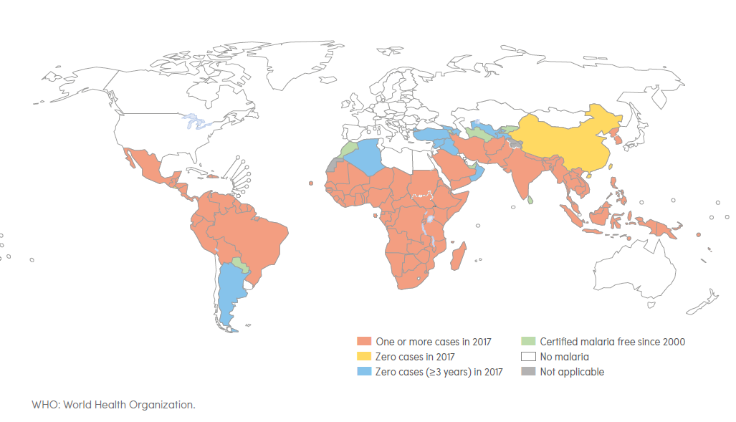
Malaria Trends & Countries
Current gold standard for detecting malaria cells is manually by trained microscopists
Manual screening performance decreases at large scales in resource strained countries
Machine-learning can help large-scale screening without compromising accuracy
Convolutional Net most popular choice but has high variance
Source: Figure generated using WHO Malaria Report 2018 Table 6.1 pg. 37
Source: WHO Malaria Report 2018 pg. 2

Slide 3
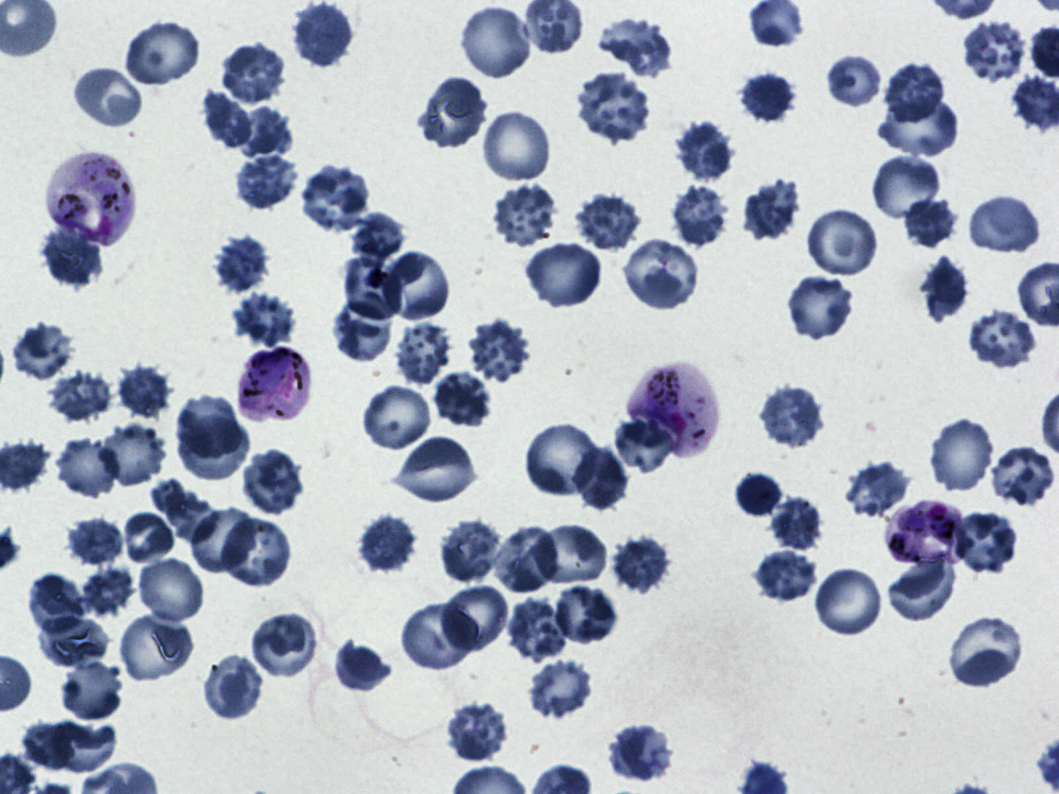
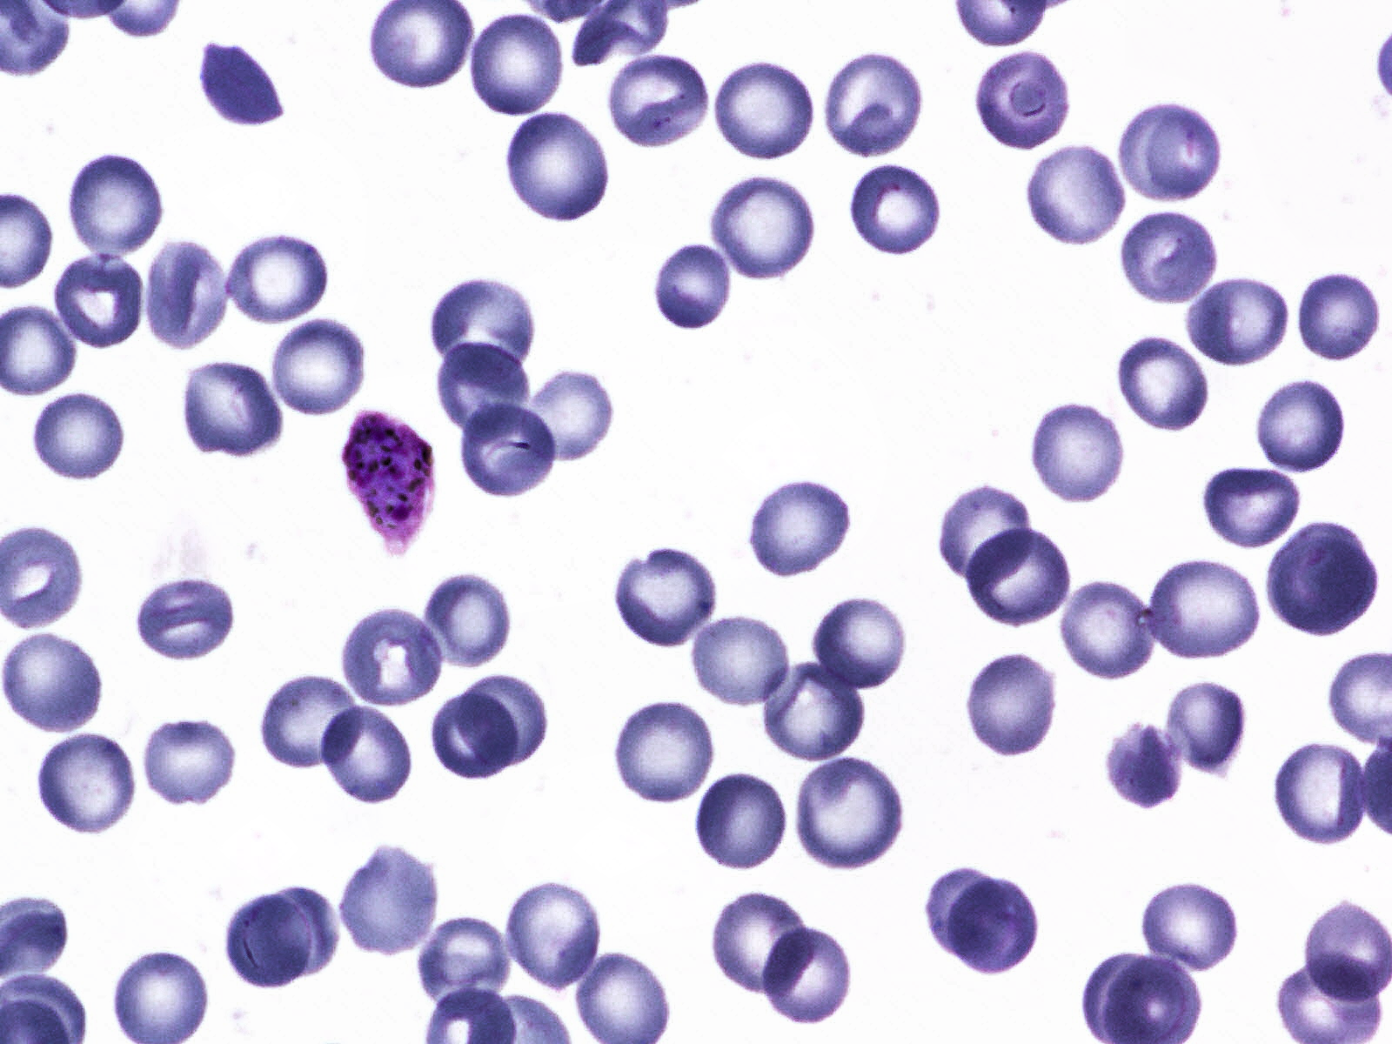
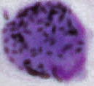
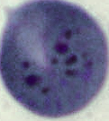
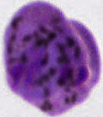
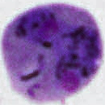
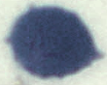
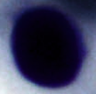
Wholeslide Microscopy Images
Infected Cells
Uninfected Cells
Gametocyte
Ring
Schizont
Trophozoite
Red-blood cell
White blood cell

Slide 4
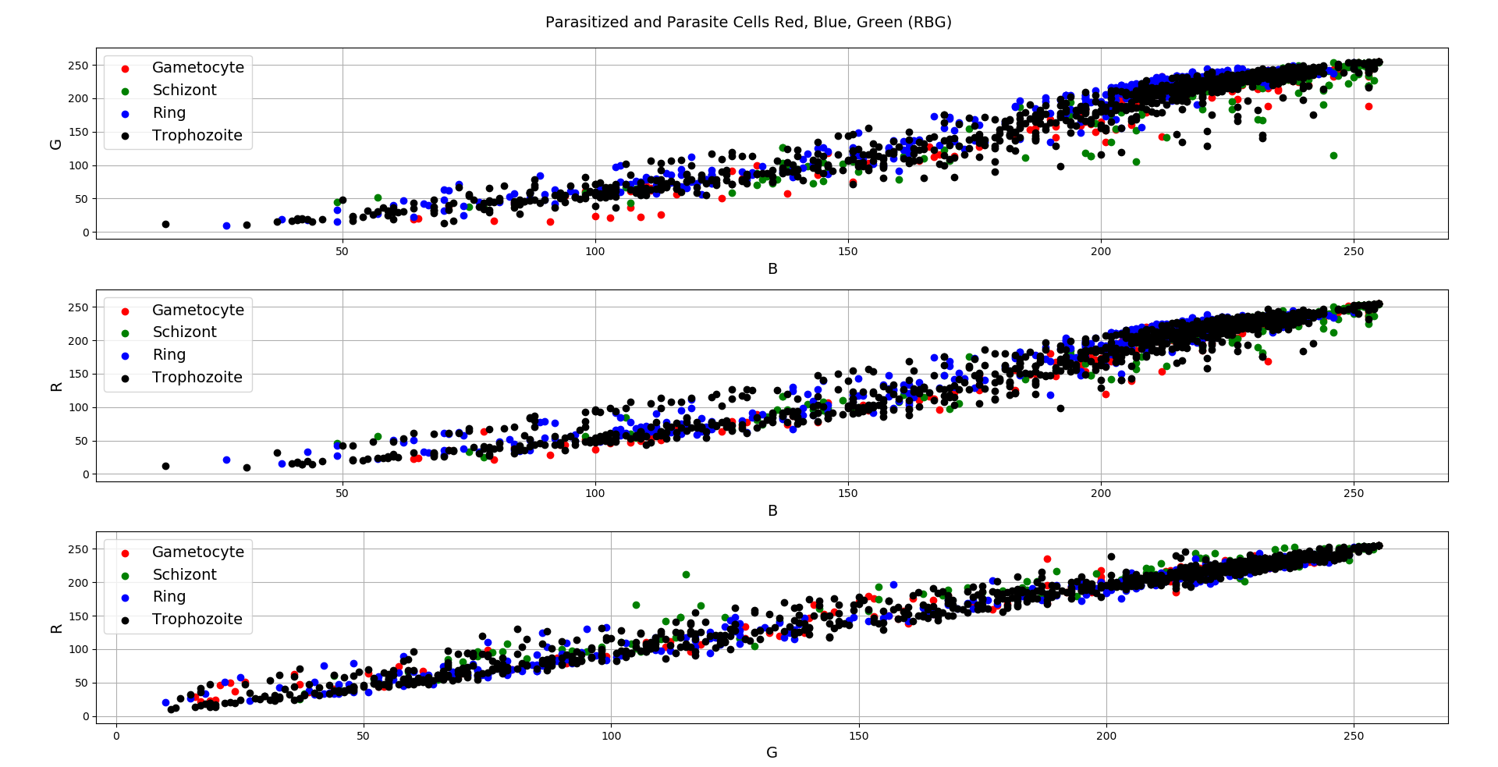
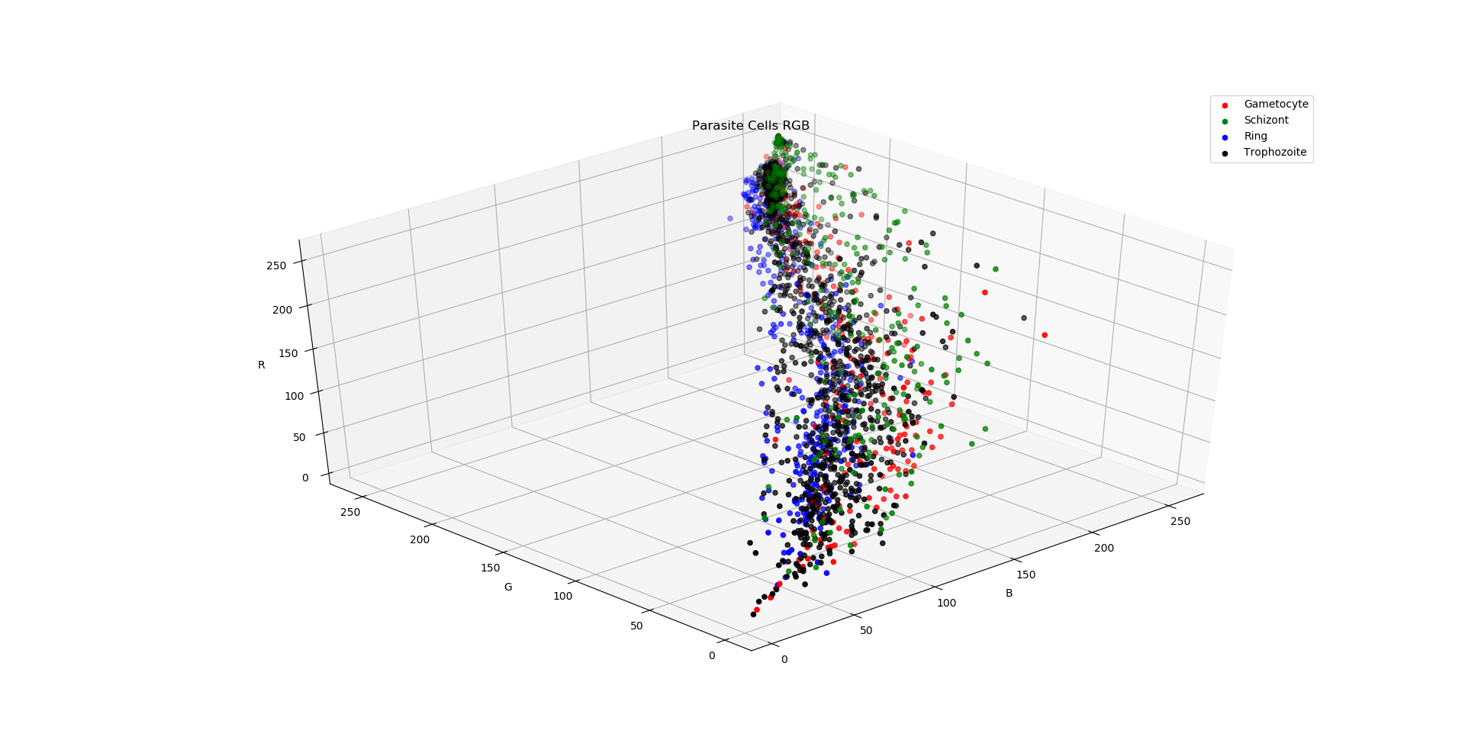
Red, Green, Blue (RGB) of Infected Cell Images
Gametocyte
Ring
Schizont
Trophozoite

Slide 5
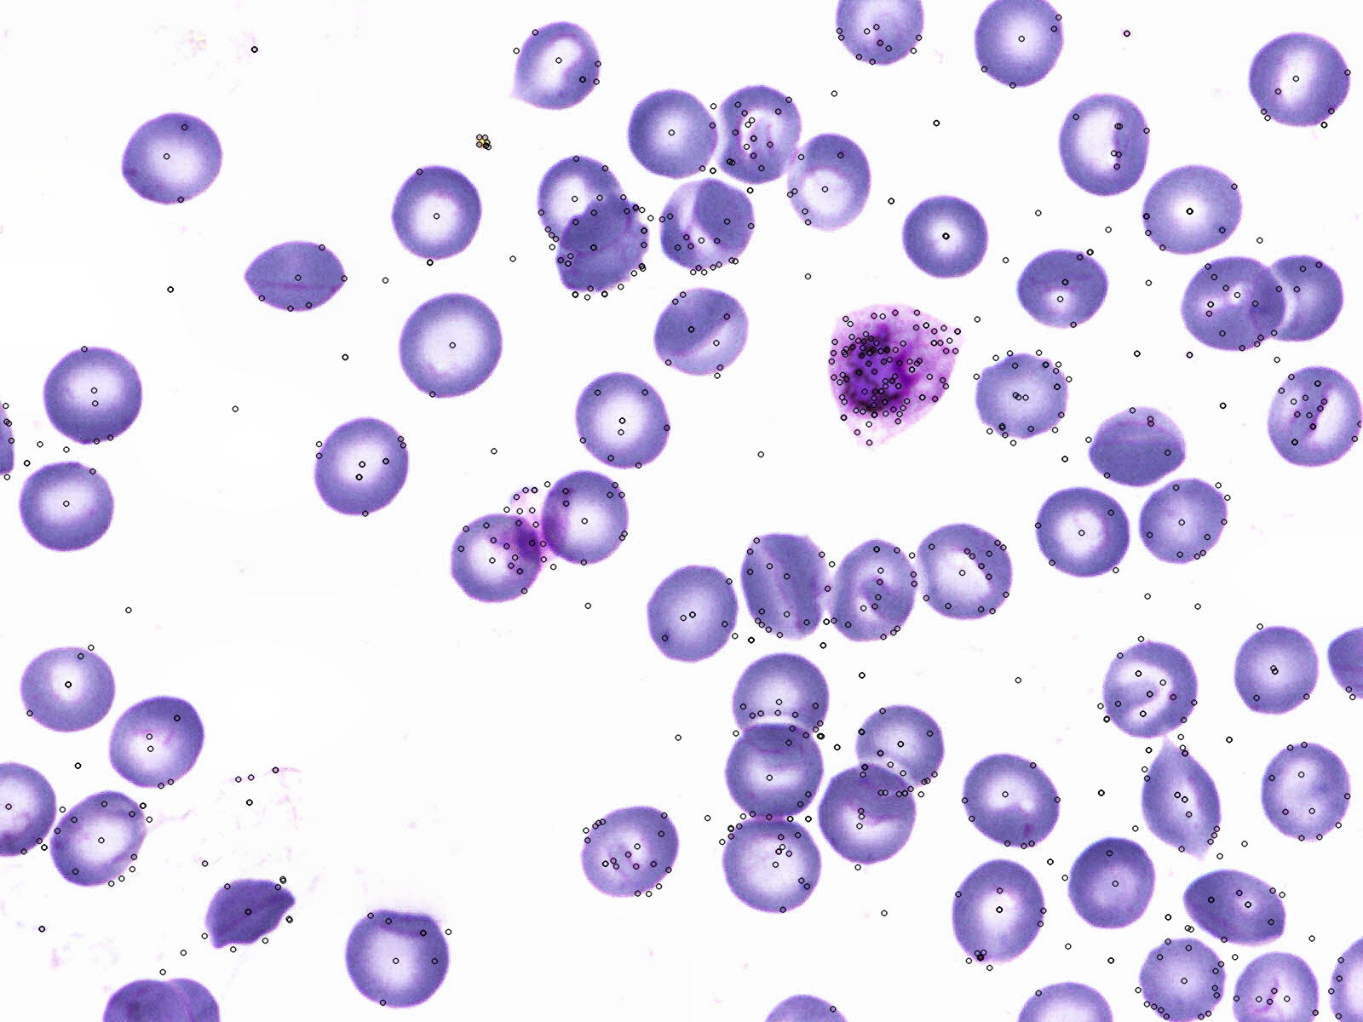
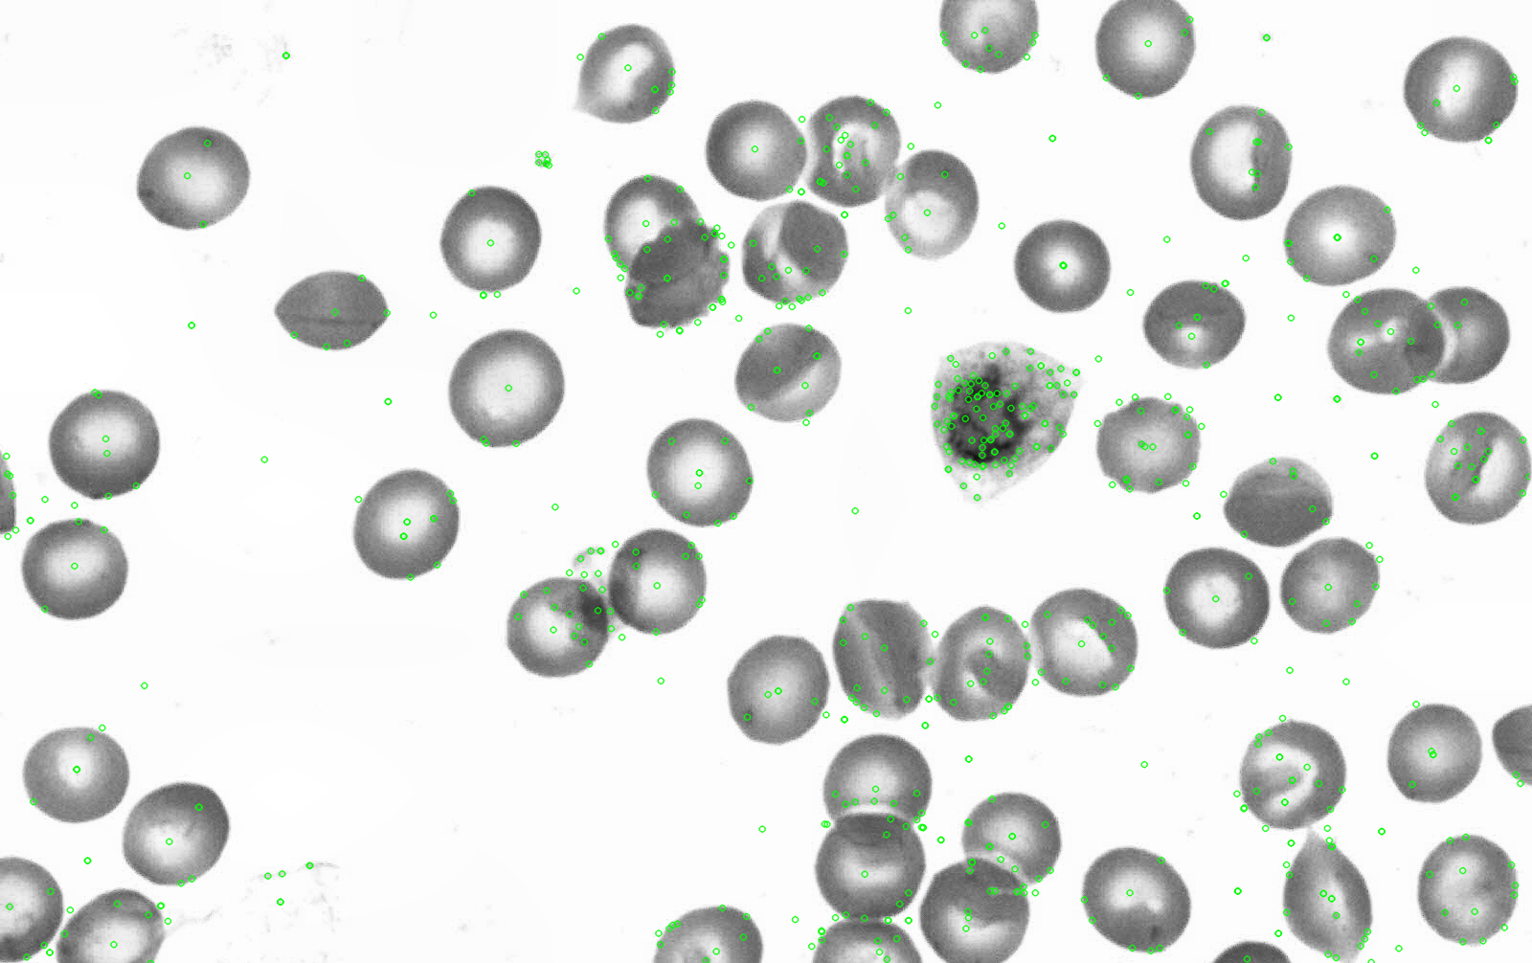
SIFT Algorithm: Feature Extractor
SIFT Descriptors: [128x1] vector per KeyPoint (per circle)
Performed on color & grayscale images

Slide 6
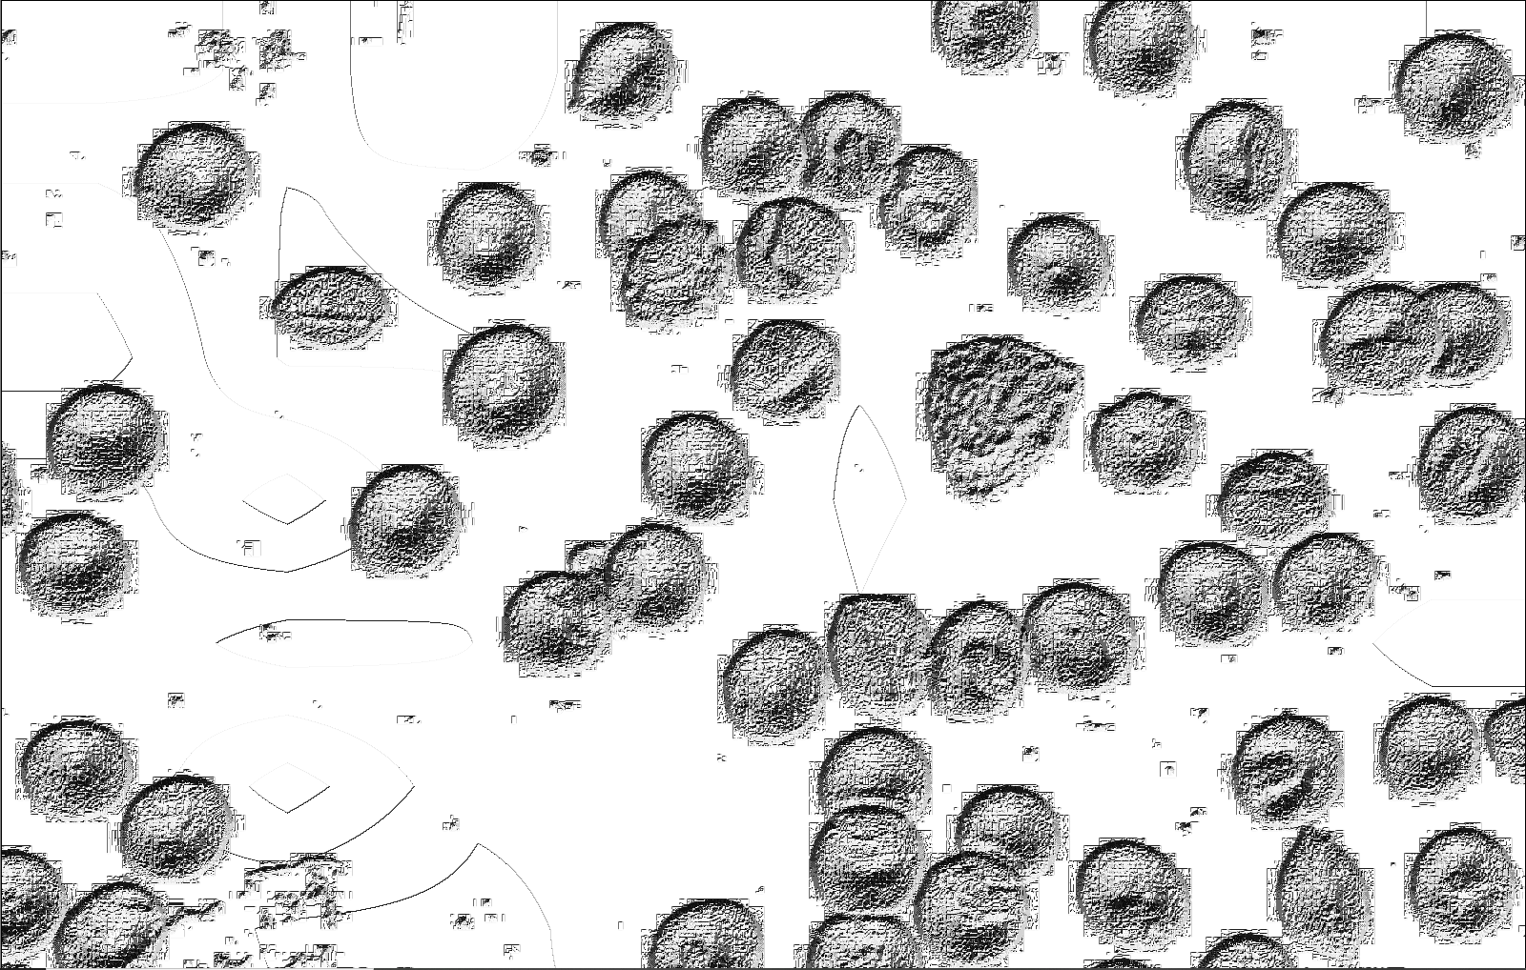
Random Forest & Neural Net with Local Binary Pattern + SIFT
Grayscale SIFT image on the left, same image outputted by Local Binary Pattern (LBP) algorithm on the right. LBP gives images textures which could potentially be used for classification.

Slide 7
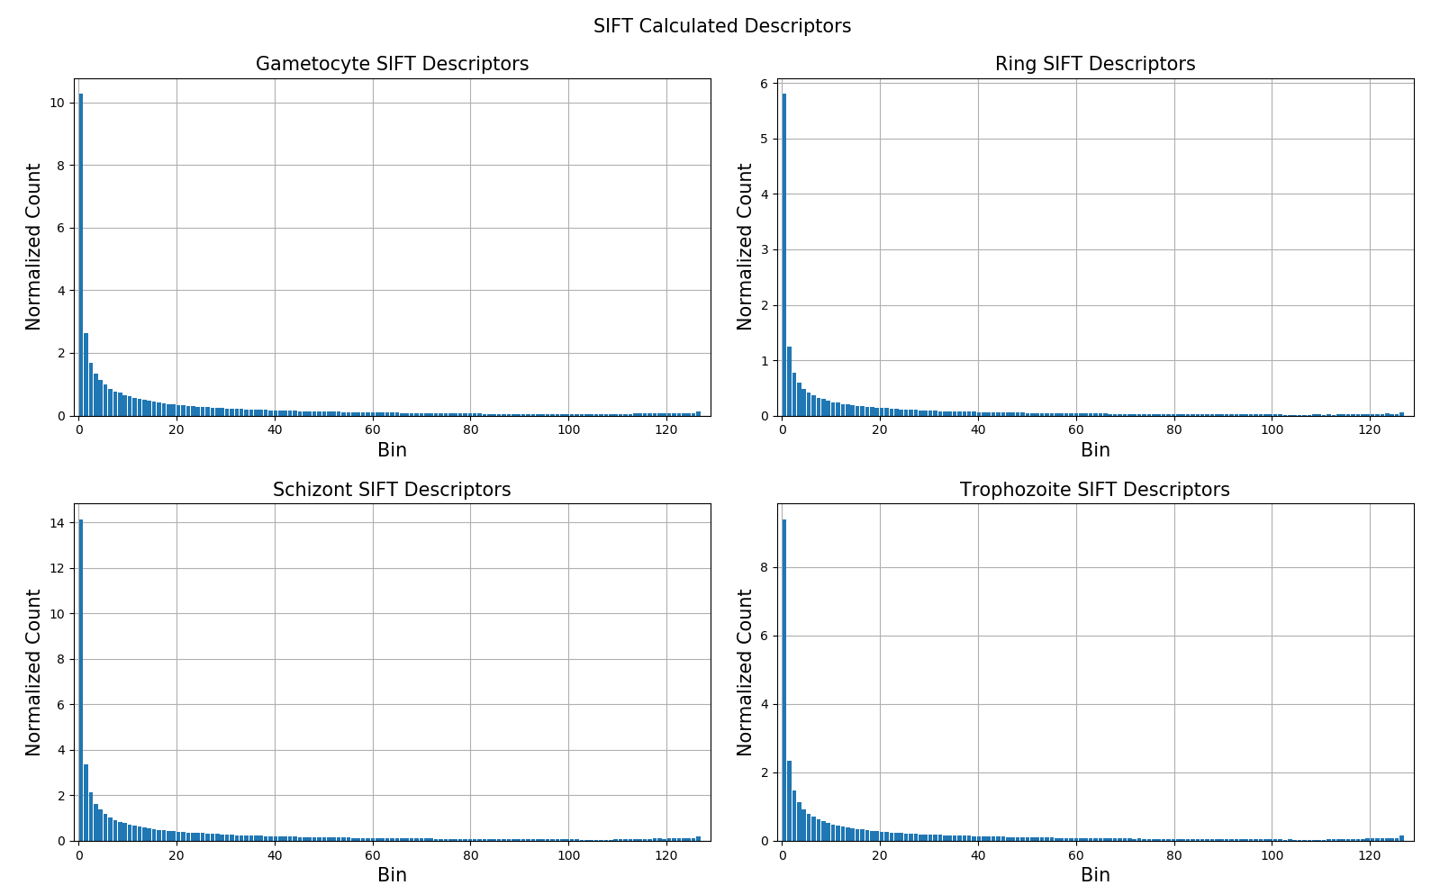
Principal Component Analysis (PCA) on SIFT Extracted Features
Histograms of normalized SIFT calculated descriptors of infected gametocytes, rings, schizonts, and trophozoites. The histogram reveals that the infected cells are very similar but there does appear to be a way to classify the different cell types based on bins 1-20; schizonts have the largest and most dark regions, followed by gametocytes, trophozoites, and rings which is consistent with what can be confirmed visually in Slide 3.
Variance Ratio (%) vs. number of PCA components for SIFT and SIFT-LBP extracted features. The graph demonstrates that 66 components in SIFT and 190 components in SIFT-LBP contain approximately 93% of the information. Beyond these components, the information gain is less than 1% per component.

Slide 8
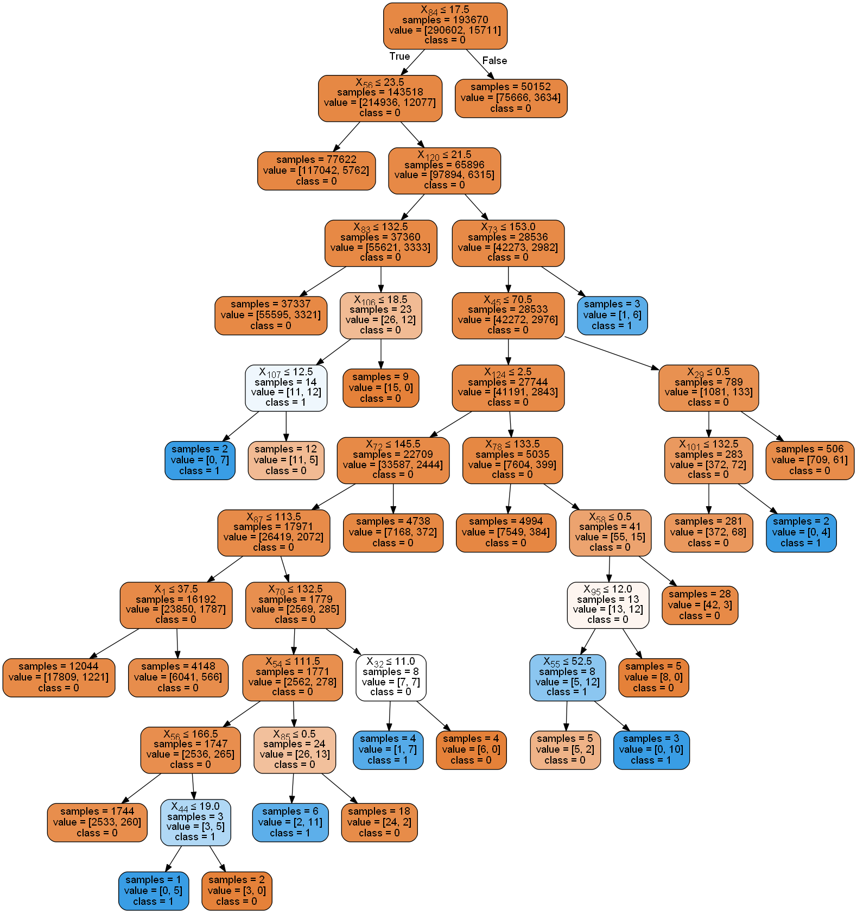
Random Forest Classifier
Testing Data Accuracy
1 Sample/Leaf, 5 trees, Error Rate: 25-26%

Slide 9
Artificial Neural Net (SIFT Only)
Training Data
7 Hidden Layers, Accuracy = 94.88%
4 Hidden Layers, Accuracy = 94.88%
Testing Data
7 Hidden Layers, Accuracy = 92.76%
4 Hidden Layers, Accuracy = 92.76%
1
2
3
4
384
1
2
3
4
64
1
2
Cell Type | # of Images Correctly Classified | # of Images Present | % Accuracy
Gametocyte | 136 | 136 | 100
Trophozoite | 540 | 596 | 91
Ring | 218 | 244 | 89
Schizont | 157 | 157 | 100
Output Layer
Input Layer
Hidden ReLu Layers (x5)
Back propagation using Negative Log Likelihood Loss

Slide 10
Final Results
 | SVM | Random Forest | Linear ANN
SIFT Accuracy (%) | NA | 73.25 | 92.77
SIFT F-Score (%) | NA | 83.29 | 96.25
SIFT-LBP Accuracy (%) | NA | 78.19 | 92.81
SIFT-LBP F-Score (%) | NA | 86.85 | 96.25
PCA-SIFT Accuracy (%) | NA | 73.25 | 92.77
PCA-SIFT F-Score (%) | NA | 82.94 | 96.25
PCA-SIFT-LBP Accuracy (%) | NA | 81.89 | 92.81
PCA-SIFT-LBP F-Score (%) | NA | 89.32 | 96.25
SIFT: SIFT (Scale-Invariant Feature Transform) extracted features
SIFT-LBP: SIFT & Local Binary Pattern (LBP) extracted features
PCA-SIFT: PCA performed on SIFT extracted features before inputting into learning machine
PCA-SIFT-LBP: PCA performed on SIFT & Local Binary Pattern (LBP) extracted features before inputting into learning machine

